Slide 1

Training Overview
Frank Klucznik
Joint Staff J6 DSD
11 Dec 2013

Slide 2
BLUF
This brief explains how to obtain NIEM training
DoD Adoption of NIEM Implementation Plan
Under development; led by DoD CIO
Document will discuss training
NIEM v3.0 training (100 – 300 level)
Online, Classroom, Pre-recorded Webinars
Won’t make you an expert on NIEM
Great place to get started
Available now!

Slide 3

Training Options

Slide 4


Slide 5
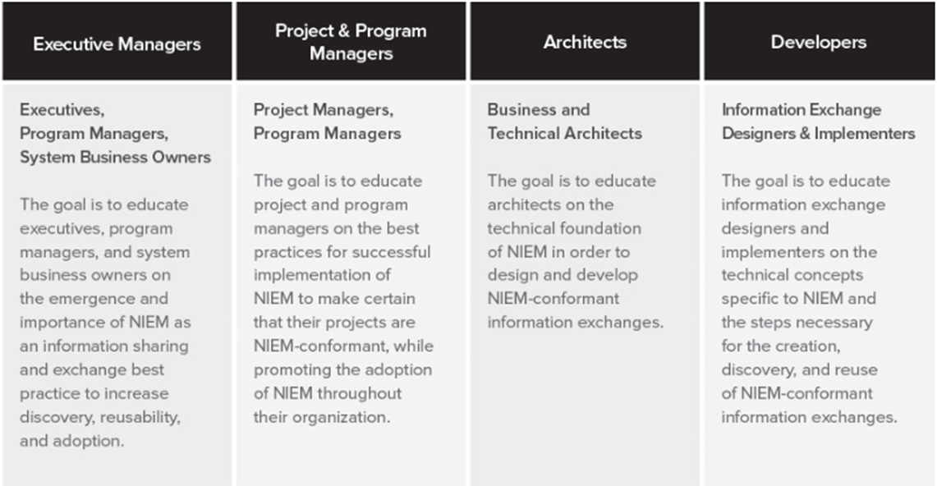
NIEM Course Tracks
Training curriculum depends on specific participant role within an organization

Slide 6
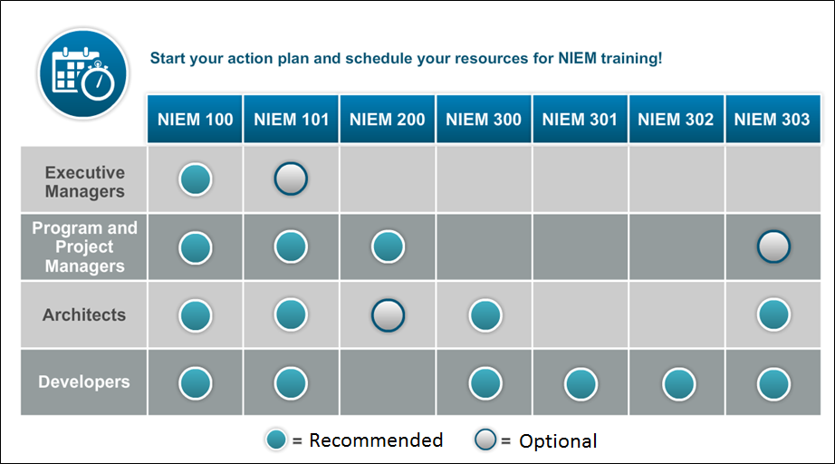
NIEM Training by Track

Slide 7
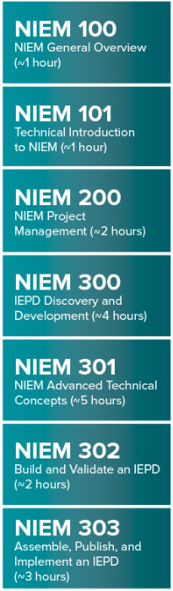
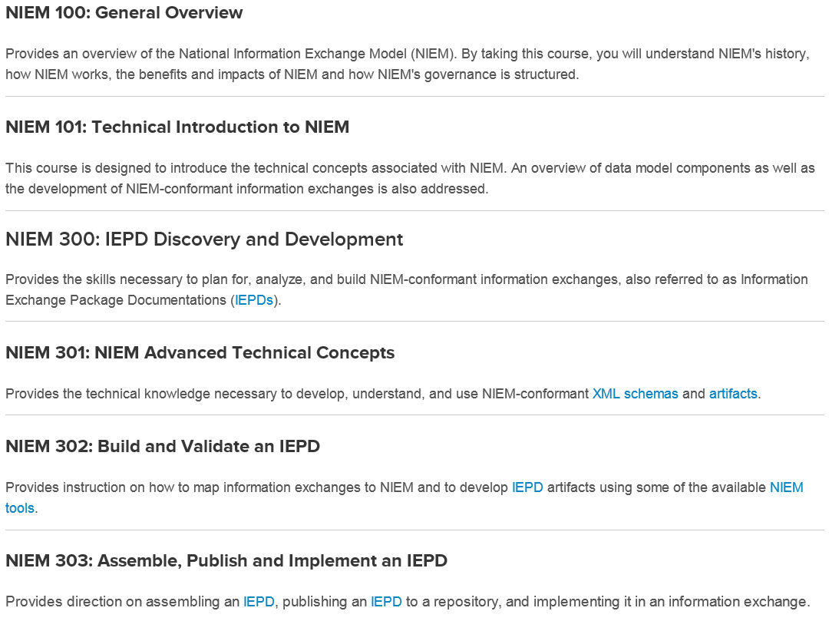
NIEM Course Descriptions
100 & 101 Courses available in mobile device format

Slide 8
